Slide 1

Exploring the Factors Behind Employee Attrition
A Data Exploration on Why Employees Leave

Slide 2
Our Aim...
Employee attrition is a critical issue for organizations aiming to retain talent and reduce the costs associated with turnover.
In this project we focus on exploring the key factors that contribute to employees leaving a company by analyzing a dataset of 1,470 records across multiple variables.
Our goal is to identify visible risk factors and to highlight subtle, hidden signs of disengagement that may be overlooked in traditional analysis.

Slide 3
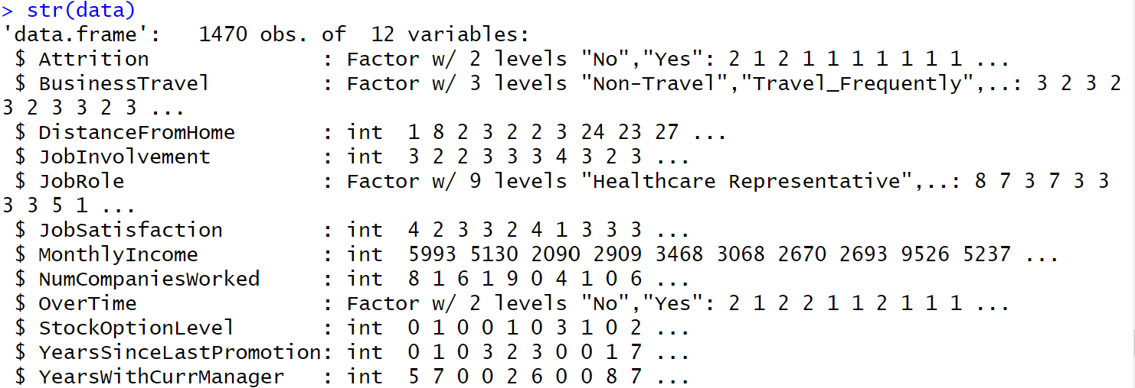
Exploratory Data Analysis (EDA)
)
The dataset includes 1,470 observations and 12selected variables used for analysis.
Among these, 8 are numeric (including both continuous and ordinal), and 4 are categorical.
Categorical variables have between 2 and 9 levels.

Slide 4
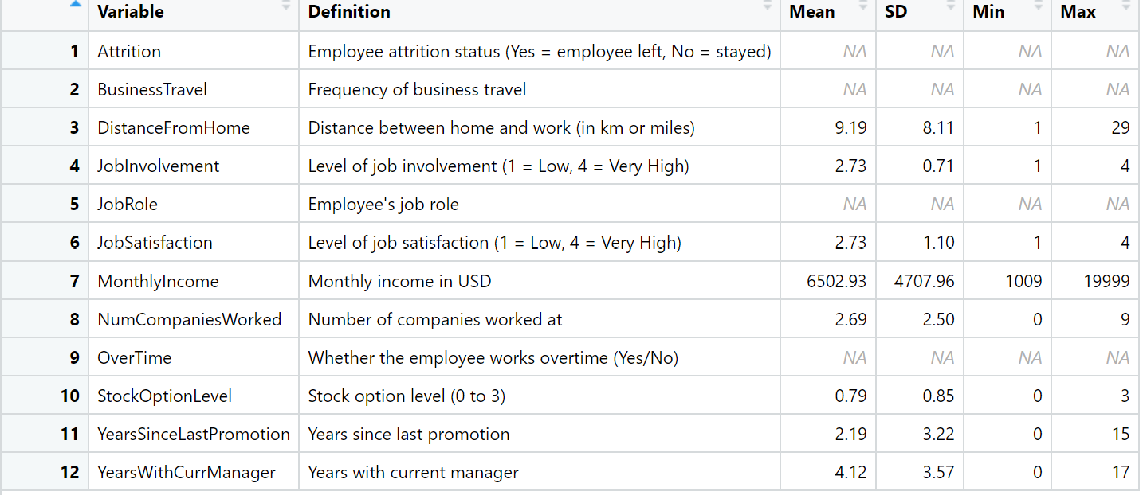
Descriptive Statistics for Selected Variables
Variable definition and summary statistics
DV
IV

Slide 5
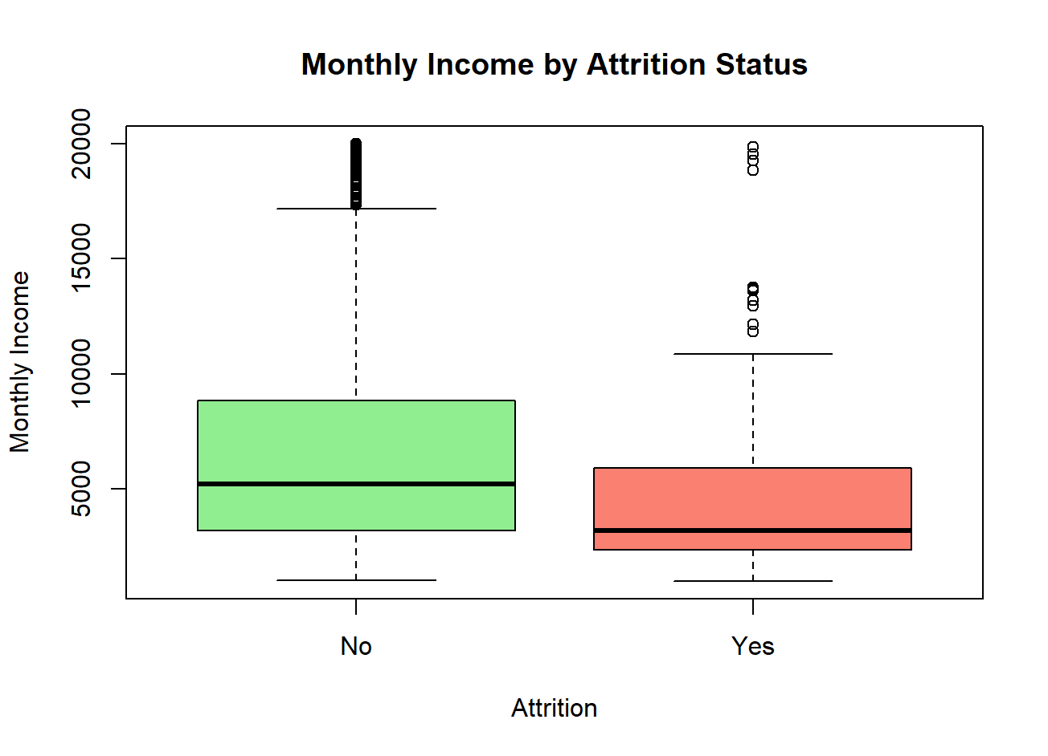
Relationship Between Income and Attrition
Employees who left the company (Attrition = Yes) tend to have lower monthly incomes on average.
In contrast, those who stayed show a wider range of income, including higher salaries.
This suggests a possible link between low pay and the likelihood of leaving, especially for employees who may feel undercompensated or undervalued.

Slide 6
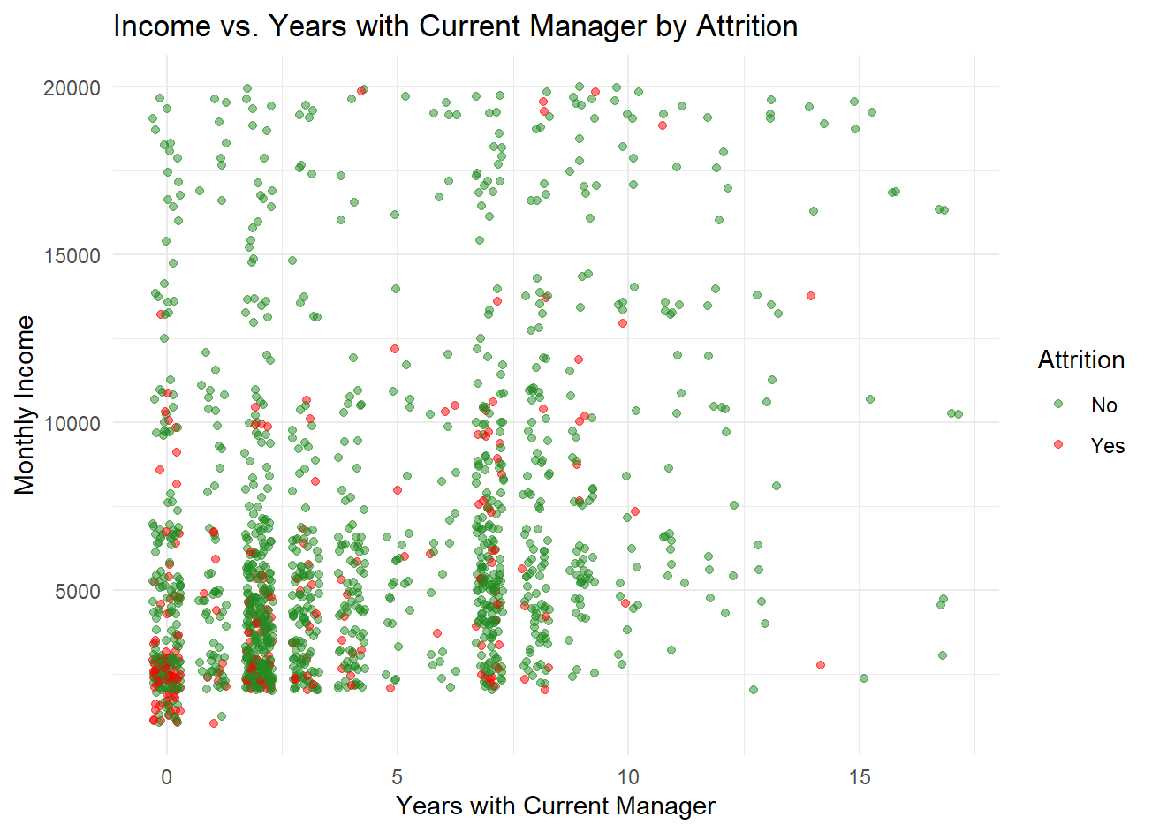
The Role of Income and Manager Tenure on Attrition
This scatter plot compares Monthly Income vs Years with Current Manager by Attrition.
Employees who left (red dots) are more concentrated in the early years of working with their manager.
Longer manager relationships (5+ years) are mostly associated with employees who stayed (green dots).
Interestingly, employees with higher income also seem more likely to stay, especially after a few years.
This suggests that manager-employee relationships and salary may both contribute to long-term retention.

Slide 7
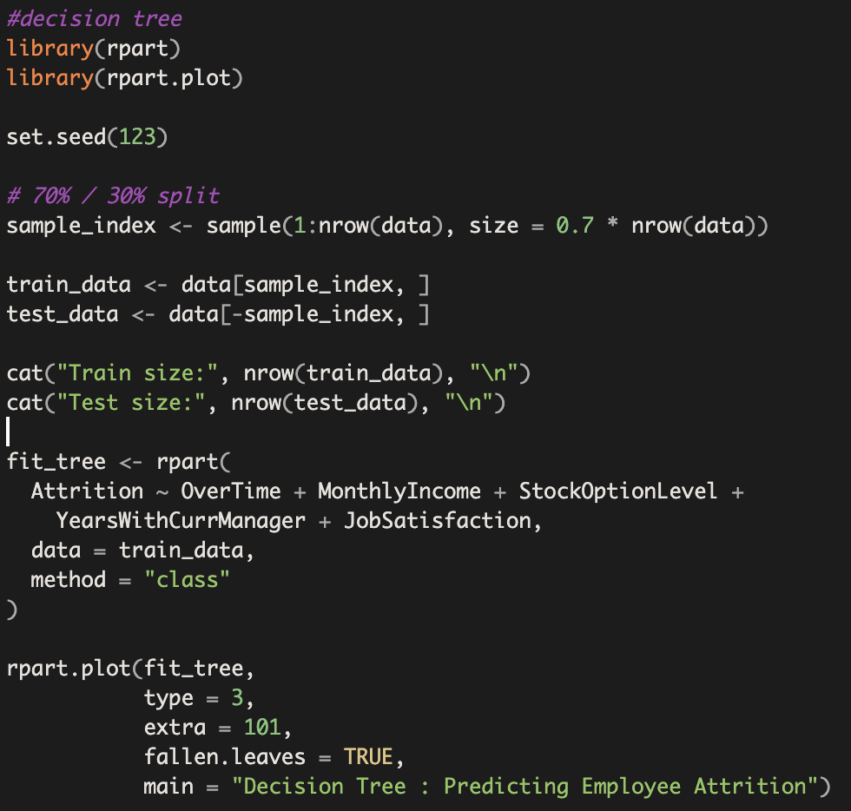
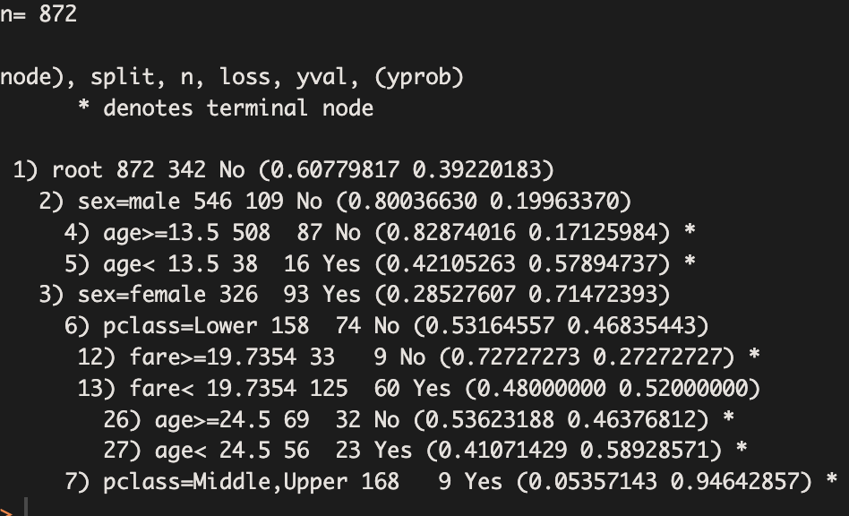
Decision Tree:

Slide 8
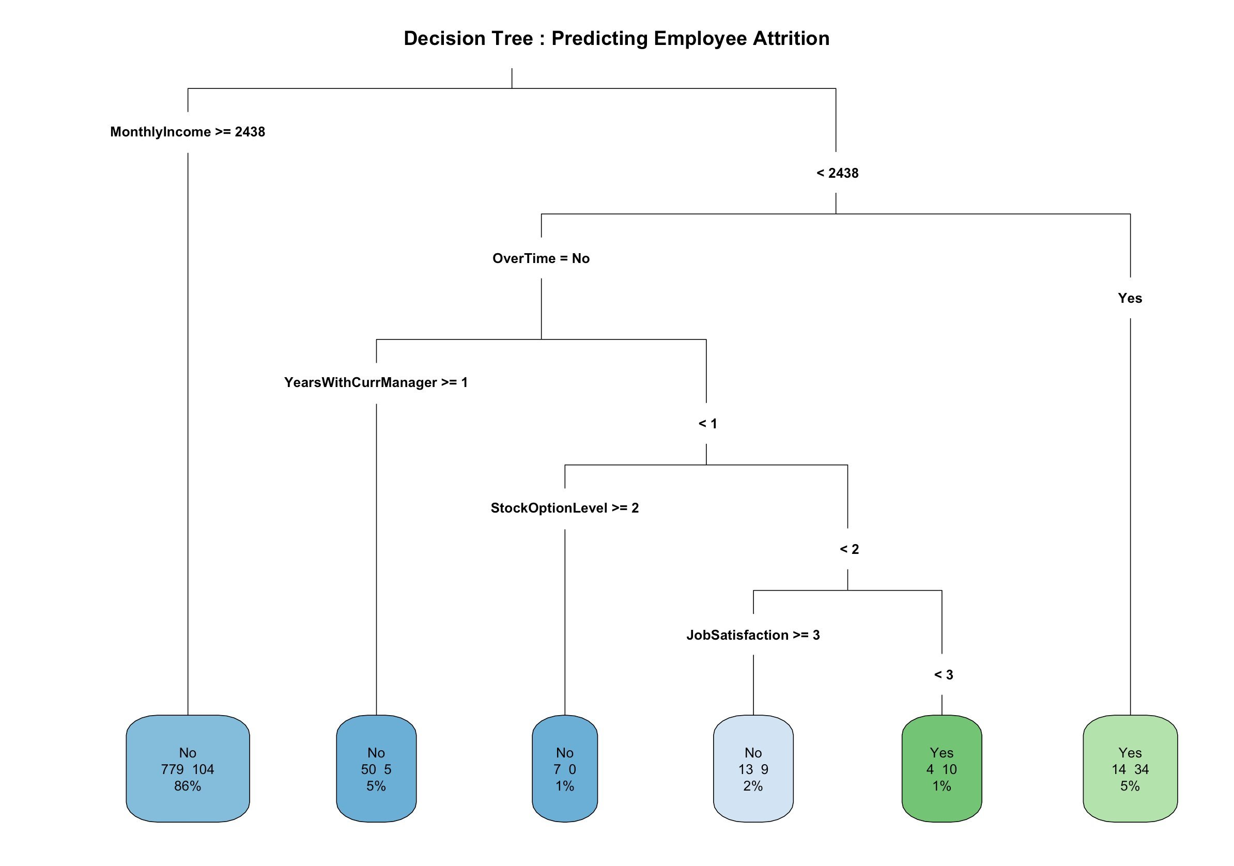

Slide 9
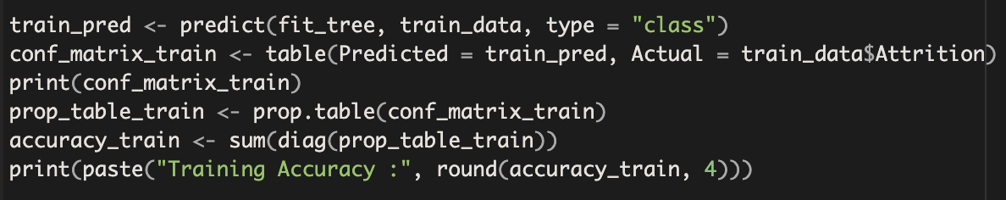
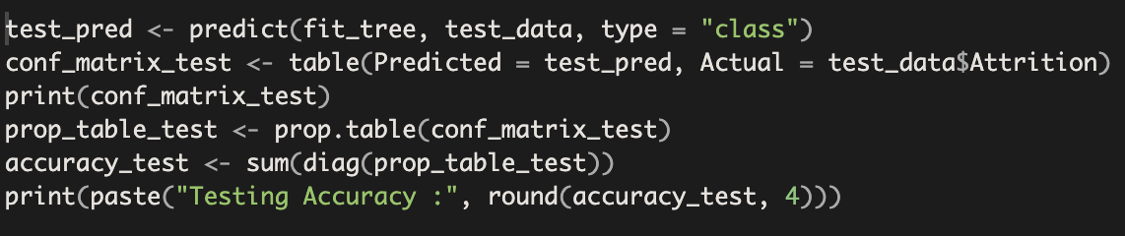
Decision Tree:
 | Total
TP | 44
FP | 18
TN | 849
FN | 118
Training Accuracy: 0.8678 = 86.78%
 | Total
TP | 11
FP | 11
TN | 355
FN | 64
Testing Accuracy: 0.8299 = 82.99%

Slide 10
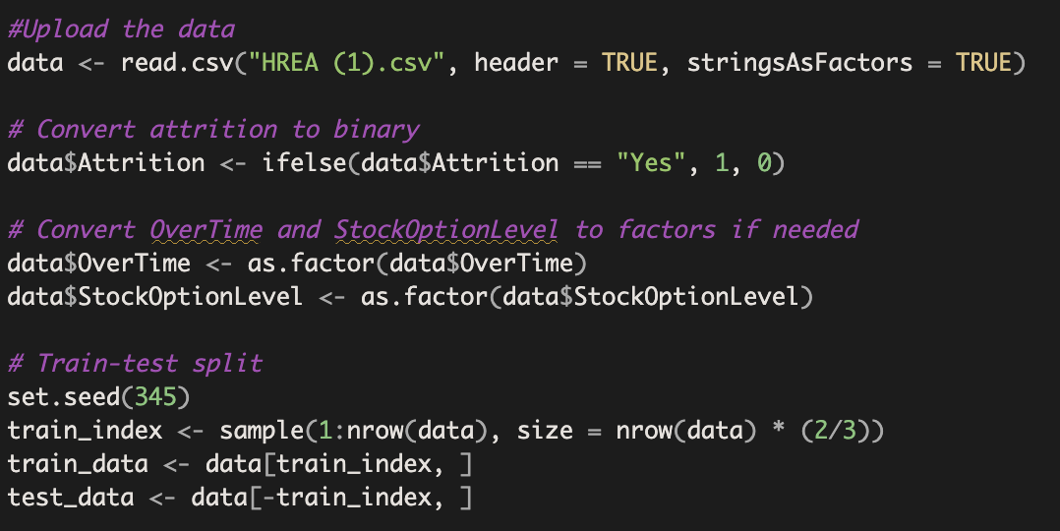
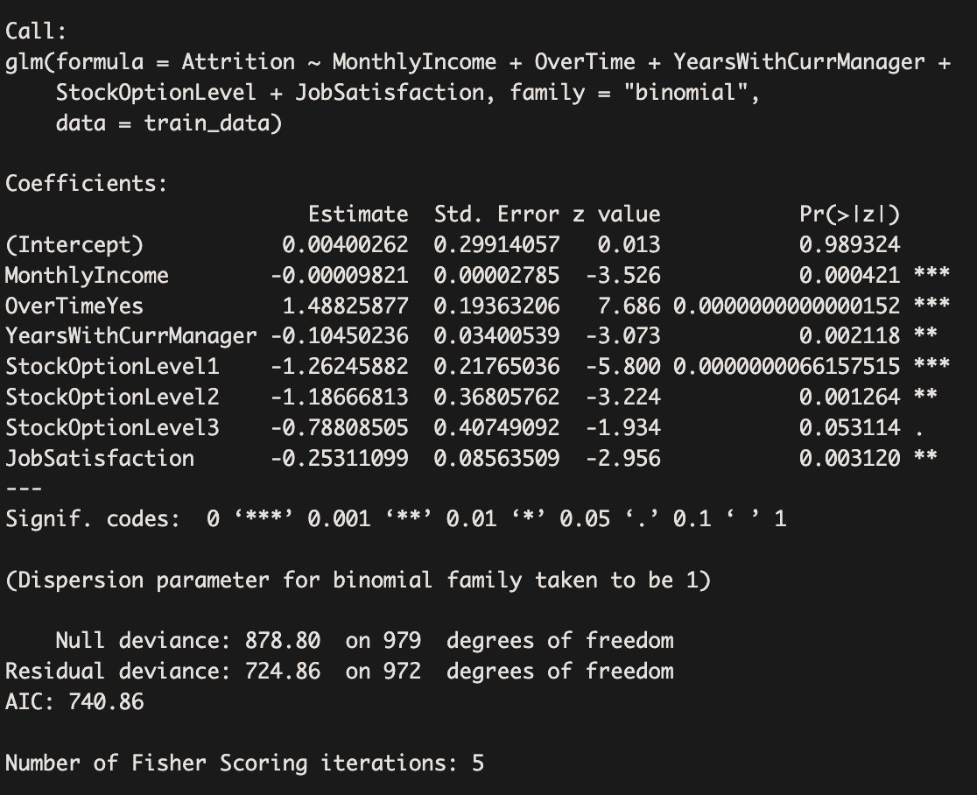
Logistic Regression:

Slide 11
Logistic Regression:
For every $1,000 increase in monthly income, the odds of attrition decrease by approximately 9%.
Employees who work overtime are approximately 343% more likely to leave than those who do not.
For every additional year with the current manager, the odds of attrition decrease by about 10.45%.
Employees with stock option level 1 are about 72% less likely to leave compared to stock option level 0.
Employees with stock option level 2 are about 69% less likely to leave compared to stock option level 0.
Employees with stock option level 3 are about 55% less likely to leave compared to stock option level 0.
For each 1-point increase in job satisfaction, the odds of attrition decrease by about 22%.

Slide 12
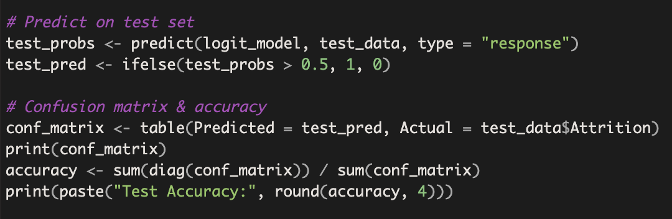
Logistic Regression:
 | Total
TP | 15
FP | 17
TN | 398
FN | 60
Test Accuracy: 0.8429 = 84.29%
TPR | 0.20​
TNR | 0.96
FPR | 0.04​
FNR | 0.80​

Slide 13
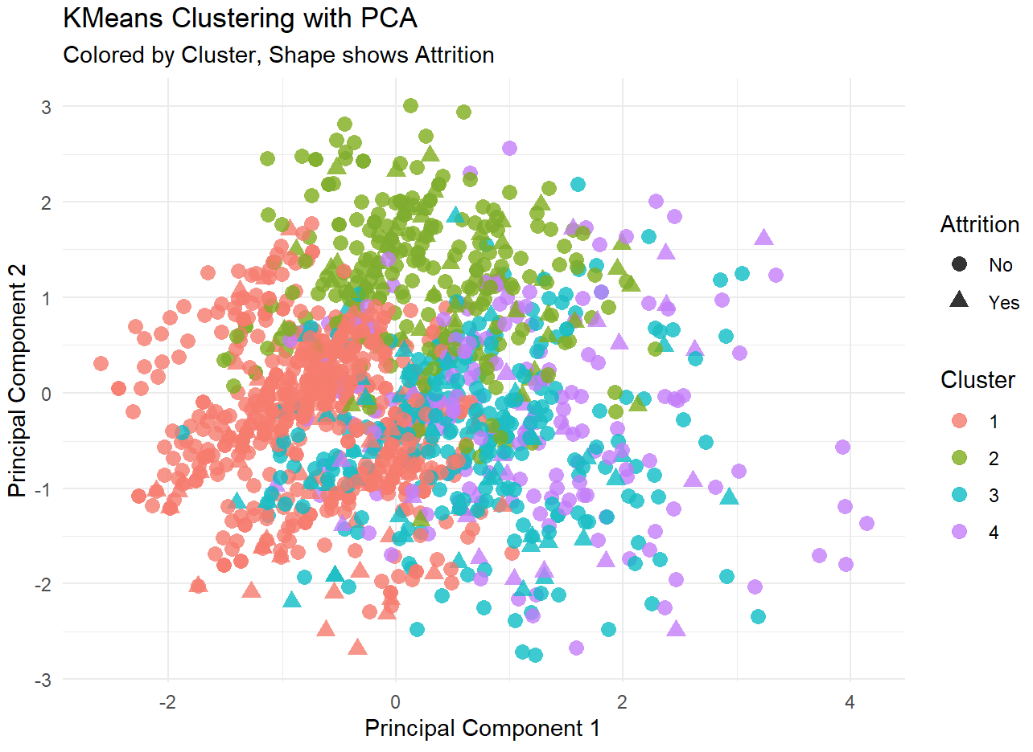
PCA Projection of Clusters:
The PCA scatter plot shows 4 clusters (color-coded) and attrition status (shapes)
Each point represents one employee.
Circles = Stayed, Triangles = Left
Bonus: PCA & K-Means Clustering

Slide 14
Key Takeaway: Clustering Reveals Hidden Attrition Risks
 | Attrition
 | 0 | 1
1 | 591 | 94
2 | 223 | 59
3 | 260 | 52
4 | 159 | 32
 | Attrition
 | 0 | 1
1 | 86.28% | 13.72%
2 | 79.08% | 20.92%
3 | 83.33% | 16.67%
4 | 83.25% | 16.75%
KMeans (k=4) grouped employees based on behavioral patterns.
Cluster 1 has the lowest attrition rate with 13.72%, but the largest population (46.6% of the total).
Cluster 2 has the highest attrition rate with 20.92%.

Slide 15
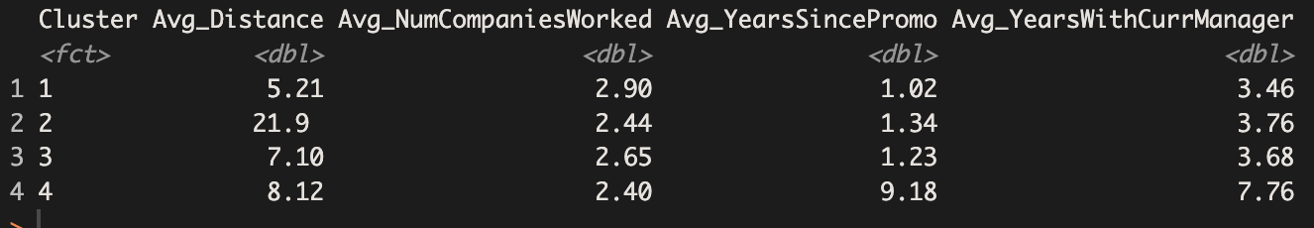
Key Takeaway: Clustering Reveals Hidden Attrition Risks
Cluster 1, which has the lowest attrition rate, has the employees with the shortest drive to work (5.21) and the most companies worked at (2.9) suggesting shorter distance and more previous jobs could help with attrition.
Cluster 2, which has the highest attrition rate, has the longest drive to work (21.9) by a significant margin suggesting that a long commute may increase attrition.
Cluster 3, which has average attrition rate, contains employees with very long average years since promotion (9.18) and years with current manager (7.76).
Cluster 4 employees may be quietly disengaged despite appearing stable. That’s why HR analytics must go beyond visible patterns — sometimes, the silence tells the loudest story.

Slide 16
Conclusion
Through this project, we gained insights into employee attrition and got a deeper understanding of the analytical tools and techniques essential for real-world data exploration.
By performing Exploratory Data Analysis (EDA), we learned how to clean, summarize, and visualize data effectively to uncover initial trends and patterns.
The decision tree model helped us grasp how rules can be derived from data to classify outcomes and interpret decision paths.
Using logistic regression, we developed our ability to quantify the impact of individual variables like salary, overtime, and job satisfaction on the probability of attrition.
We also ventured into unsupervised learning with K-Means clustering and Principal Component Analysis (PCA), which taught us how to uncover hidden patterns and group employees based on similar behaviors, independent of their attrition status.
Most importantly, we learned that effective data analytics goes beyond simply applying models, it involves thoughtful interpretation, storytelling, and understanding the business implications behind the data.

Slide 17
Dataset Overview
Variable | Type | Definition
Attrition | Categorical (Binary) | Employee attrition status (Yes = employee left, No = stayed)
BusinessTravel | Categorical | Frequency of business travel
DistanceFromHome | Continuous | Distance between home and work (in km or miles)
JobInvolvement | Ordinal (1–4) | Level of job involvement (1 = Low, 4 = Very High)
JobRole | Categorical | Employee’s job role
JobSatisfaction | Ordinal (1–4) | Level of job satisfaction (1 = Low, 4 = Very High)
MonthlyIncome | Continuous | Monthly income in USD
NumCompaniesWorked | Discrete Numeric | Number of companies worked at
OverTime | Categorical (Binary) | Whether the employee works overtime (Yes/No)
RelationshipSatisfaction | Ordinal (1–4) | Level of relationship satisfaction (1 = Low, 4 = Very High)
StockOptionLevel | Ordinal (0–3) | Stock option level (0 to 3)
YearsSinceLastPromotion | Continuous | Years since last promotion
YearsWithCurrManager | Continuous | Years with current manager

Slide 18
Presentation Overview
Dataset Overview
Exploratory Data Analysis
Descriptive Statistics
Attrition Trends
Relationship between Income and Attrition
Impact of Overtime
Role of income and Manager Tenure

Slide 19
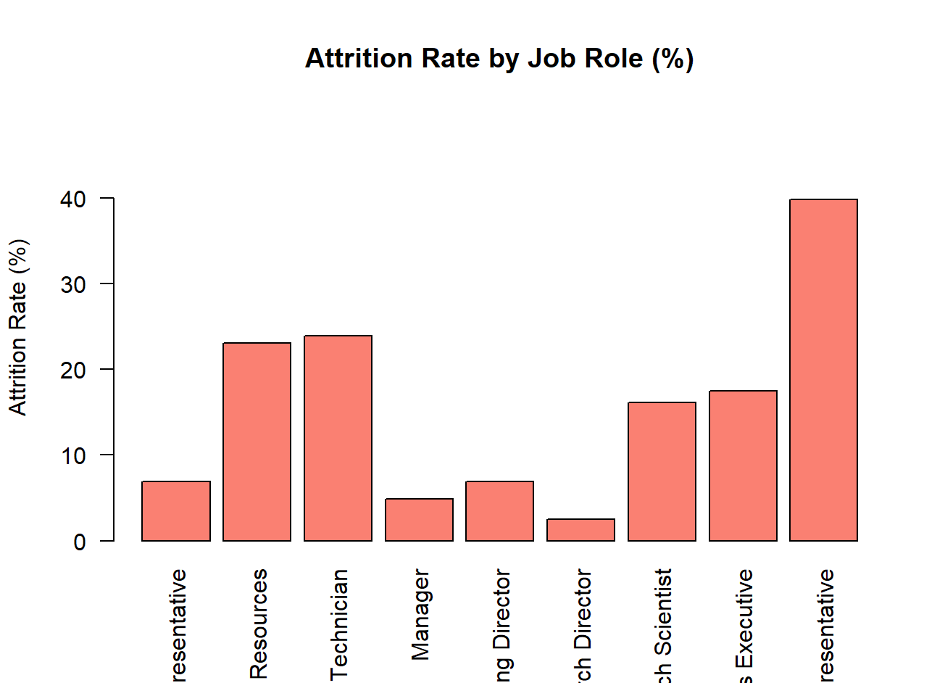
Attrition Trends Across Job Roles
As we can see, not all job roles are equal when it comes to employee retention.
Sales Representatives are leaving at the highest rate — nearly 40%.
On the other hand, roles like Manager and Research Director show strong retention.
This might suggest that roles with less support or more pressure are more vulnerable to turnover.

Slide 20
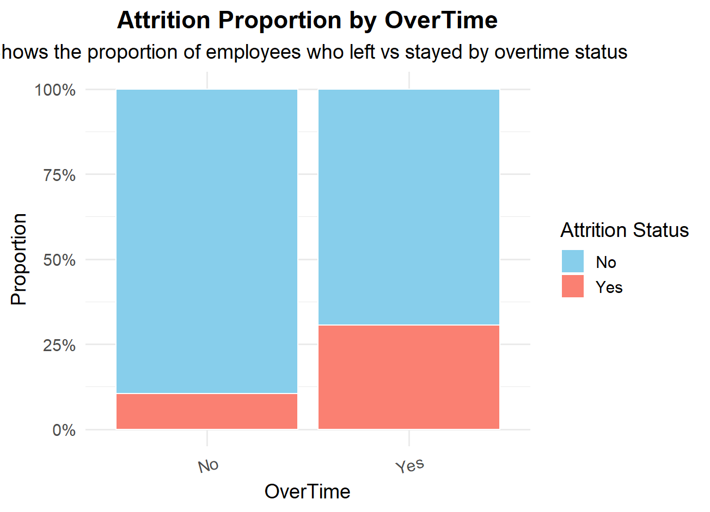
The Impact of Overtime on Employee Retention
Employees who work overtime are significantly more likely to leave the company.
In contrast, those not working overtime have a much lower attrition rate.
This pattern suggests that overtime could be a risk factor — possibly due to stress, burnout, or work-life imbalance.

Slide 21
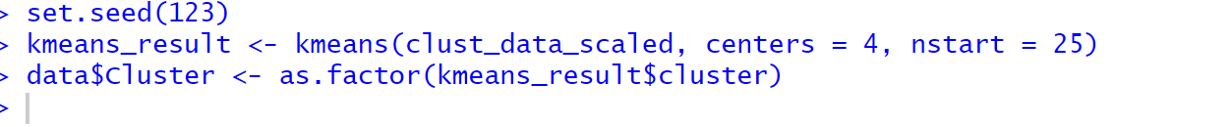
Clustering Overview & Key Findings:
Unsupervised Clustering: Identifying Hidden Risk Groups:
KMeans clustering (K = 4) was applied on five work-related features not used in previous models: Business Travel, Distance From Home, Job Involvement, Number of Companies Worked, Years Since Last Promotion
The analysis was unsupervised — attrition was not included in clustering, ensuring unbiased group formation.
Cluster 4 clearly stood out from others:
Employees in this group had over 9 years without a promotion.
Their other behaviors were relatively average.
This points to a case of hidden dissatisfaction:
Workers may appear stable, but long-term stagnation could increase attrition risk

